Slide 1
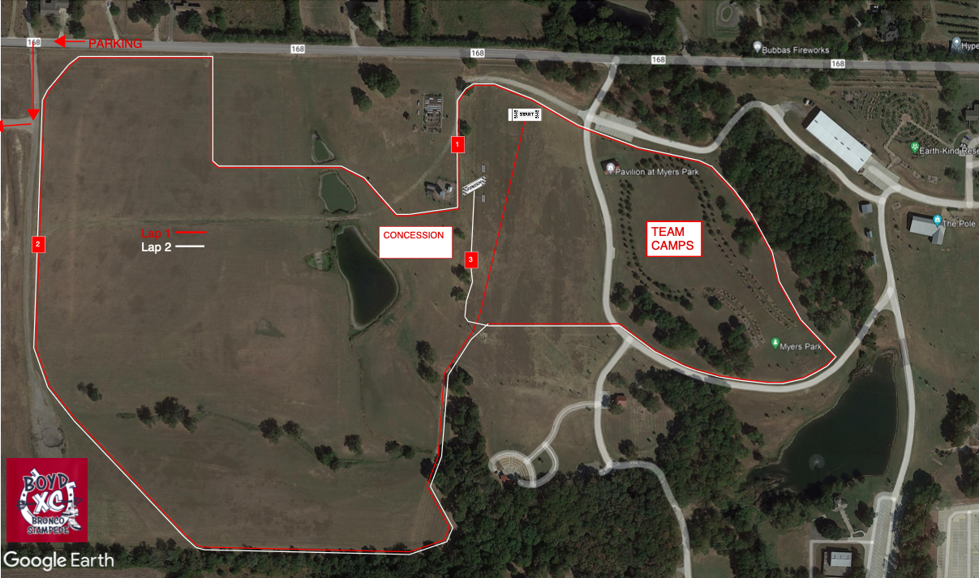
COURSE MAP
BUS ENTRANCE
TEAM CAMPS
TO BUS PARKING

Slide 2
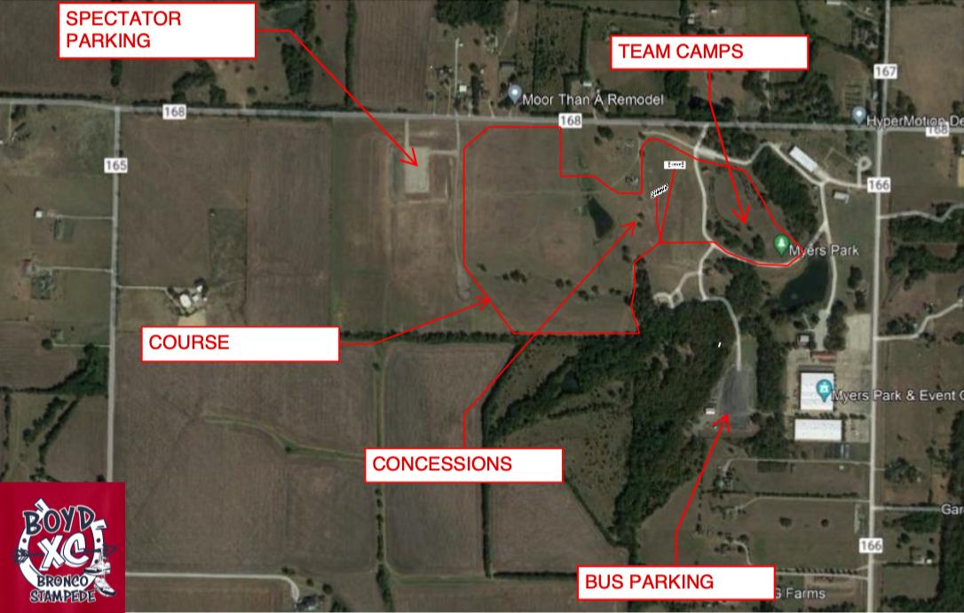
PARKING MAP

Slide 3
1ST AID
VOLUNTEER MAP
BUS ENTRANCE
8
5
6
9
7
11
1
4
10
TEAM CAMPS
3
2
TO BUS PARKING

